Slide 1
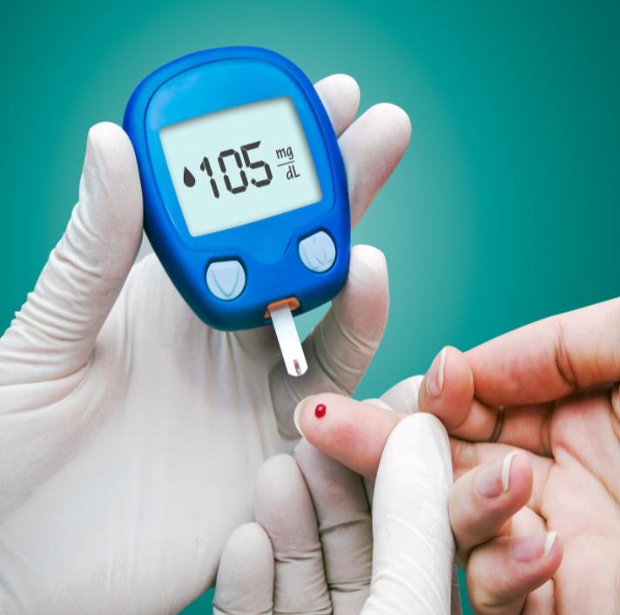

Project Report On Healthcare
Submitted by
Debatri Roy
PGP DS MAR 2021 cohort 1

Slide 2
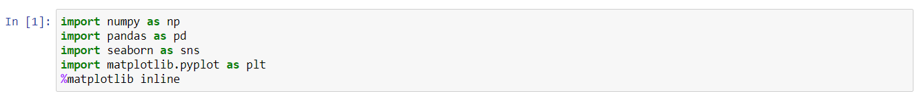
Source code
Including library functions of packages
Load the Dataset
Print the Dataset
Print first few rows of the dataframe

Slide 3
Source code
Data Exploration
Checking for Null Values
Checking the information
Describing the Data frame
Standard deviation of variables
Filter the positive outcome values and print the first few columns with positive outcome

Slide 4
Source code
Counting the number of heads of particular Glucose value and Print first few rows
Plot the Histogram for Glucose values
Counting the number of heads of particular Blood Pressure value and Print first few rows
Plot the Histogram for Blood Pressure values
Counting the number of heads of particular Skin Thickness value and Print first few rows

Slide 5
Source code
Plot the Histogram for Skin Thickness values
Counting the number of heads of particular Insulin value and Print first few rows
Plot the Histogram for Insulin values
Counting the number of heads of particular BMI value and Print first few rows
Plot the Histogram for BMI values
Describe and then Transpose the Data Frame

Slide 6
Source code
Plot the Histogram for Positive BMI values
Counting the number of heads of particular Positive BMI value and Print first few rows
Plot the Histogram for Positive Glucose values
Counting the number of heads of particular Positive Glucose value and Print first few rows
Plot the Histogram for Positive Blood Pressure values
Counting the number of heads of particular Positive Blood Pressure value and Print first few rows

Slide 7
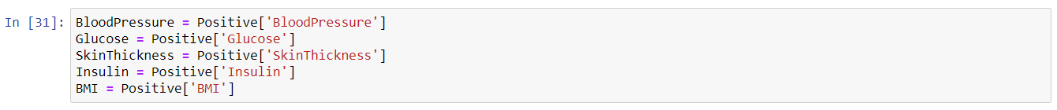
Source code
Plot the Histogram for Positive Skin Thickness values
Counting the number of heads of particular Positive Skin Thickness value and Print first few rows
Plot the Histogram for Positive Insulin values
Counting the number of heads of particular Positive Insulin value and Print first few rows
Scatter Plot
Assigning the Positive values of the variables

Slide 8
Source code
Plotting Scatter Plot of Blood Pressure & Glucose
Plotting Scatter Plot of Glucose & Blood Pressure
Plotting Scatter Plot of BMI & Insulin
Plotting Scatter Plot of Skin Thickness & Insulin
Correlation Matrix

Slide 9
Source code
Correlation Heat Map
Getting Correlation Values
Getting Correlation Values
Data Modeling
Logistic Regression and Model Building
Print first few rows of the data dataframe

Slide 10
Source code
Assigning Values to features and label
Split the dataset into Train and Test set
Creating Logistic Regression model
Printing Train and Test Score

Slide 11
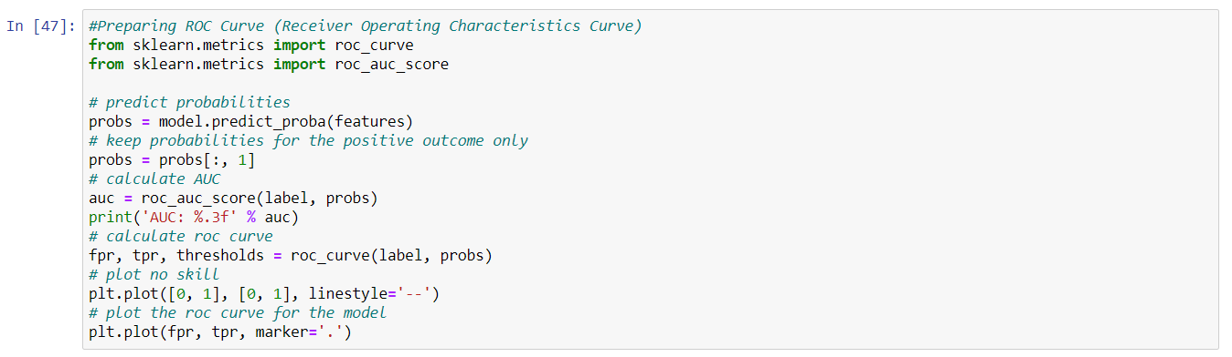
Source code
Getting Confusion matrix
Getting Classification Report
Preparing ROC Curve

Slide 12
Source code
Applying Decision Tree Classifier
Calculating Training Score of Decision Tree Classifier
Calculating Test Score of Decision Tree Classifier
Applying Random Forest Classifier

Slide 13
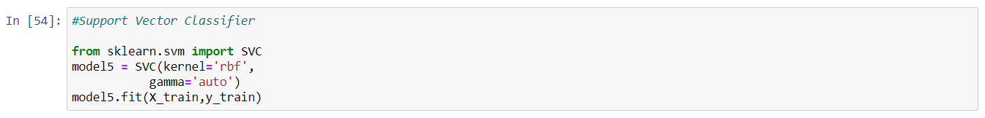
Source code
Calculating Training Score of Random Forest Classifier
Calculating Test Score of Random Forest Classifier
Applying Support Vector Classifier
Calculating Training Score of Support Vector Classifier
Calculating Test Score of Support Vector Classifier

Slide 14
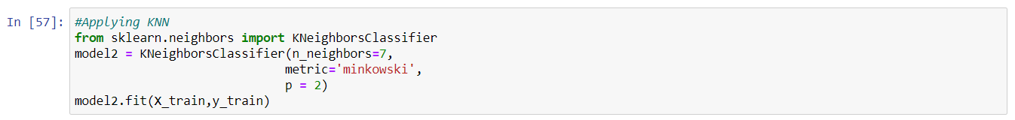
Source code
Applying KNN Classifier
Calculating Training Score of KNN Classifier
Calculating Test Score of KNN Classifier

Slide 15
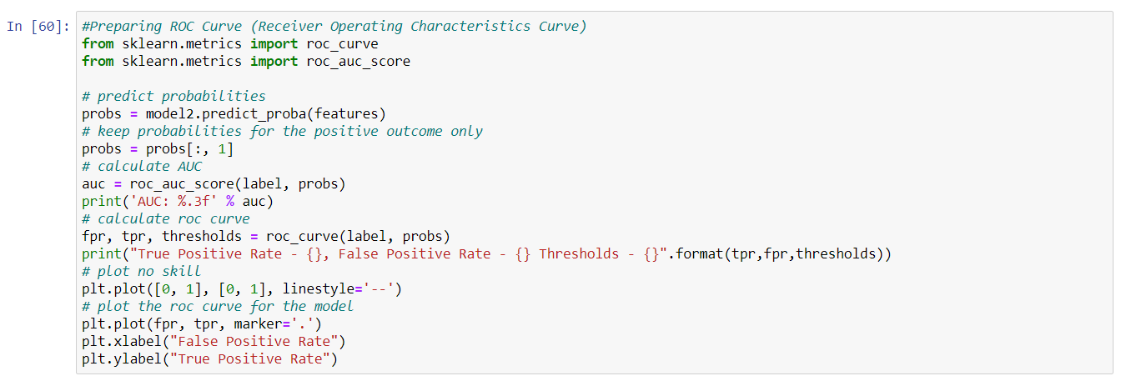
Source code
Preparing ROC Curve

Slide 16
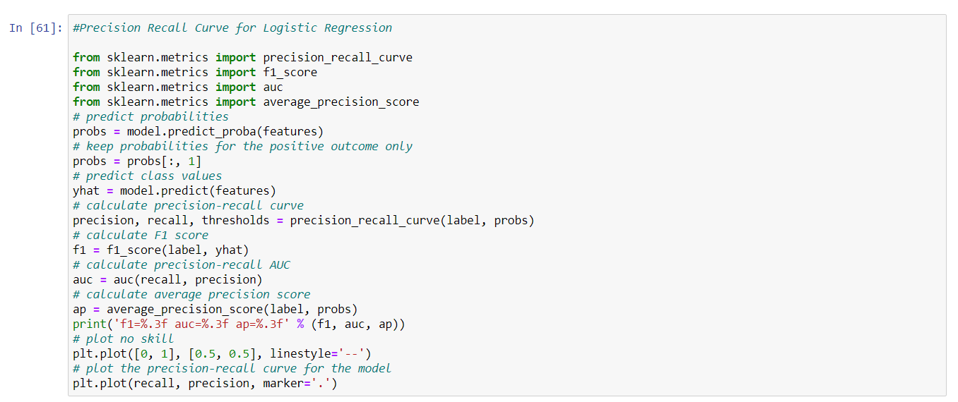
Source code
Precision Recall Curve for Logistic Regression

Slide 17
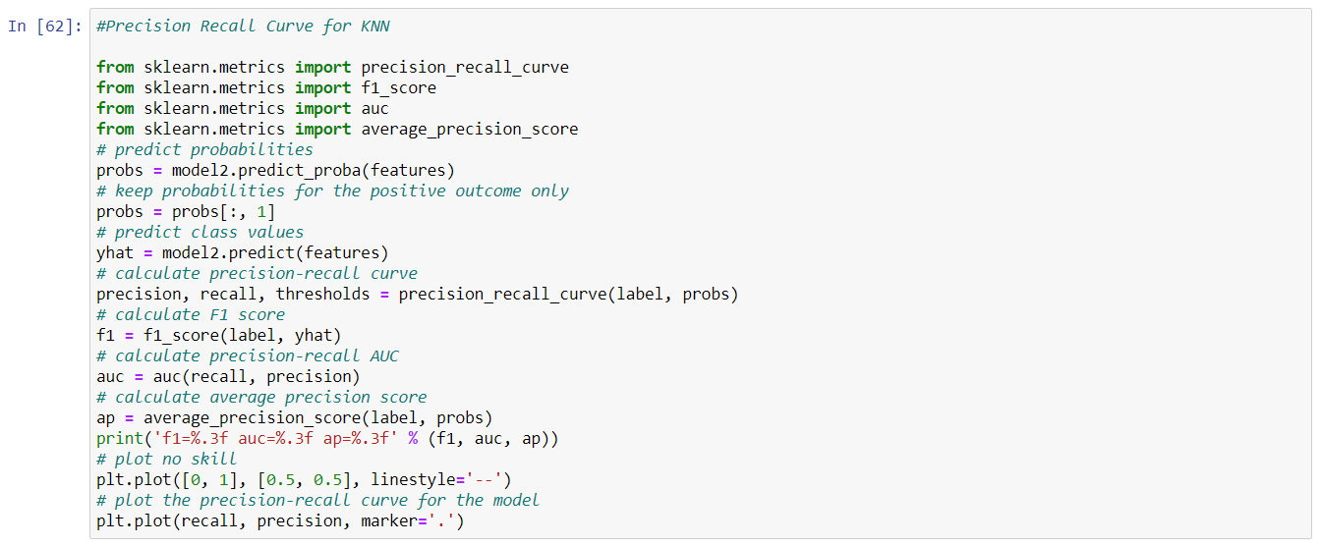
Source code
Precision Recall Curve for KNN

Slide 18
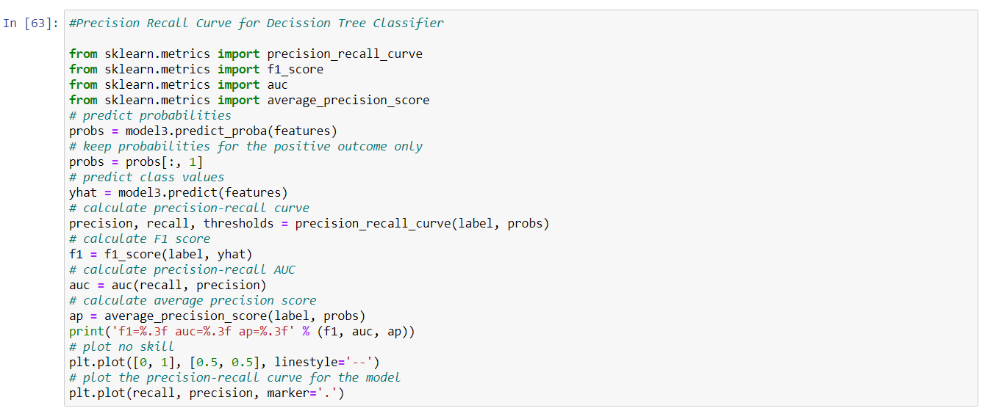
Source code
Precision Recall Curve for Decision Tree Classifier

Slide 19
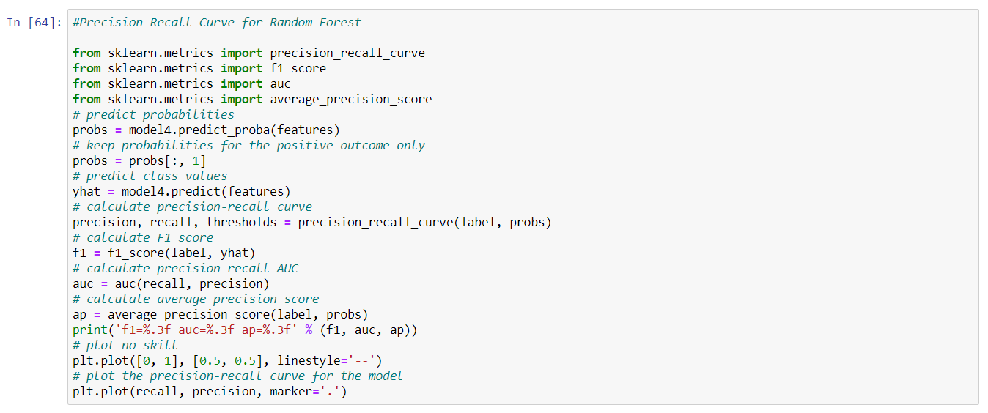
Source code
Precision Recall Curve for Random Forest

